Slide 1
Information Architecture for Standards at HFES.org
Tasha Y. David

Slide 2
Agenda
Purpose
Objectives
What we did…
What we discovered
Our game plan
Next Steps
Card Sorting Activity
Usability testing
Results
Summary & Conclusion
Recommendations

Slide 3
Purpose
Identify users who need HF standards
Professionals
Faculty
Students
Educate HFES members about standards
Who needs them
Why they need them
How they are developed
When they need to be used

Slide 4
Objectives
Help users find standards effortlessly
Help users understand where they need to go
Standards
Educational Resources
Identify usability goals for these sites

Slide 5
What we did…
User profile
Three users groups:
(1) Professional, (1) Faculty member, (1) Student
Needs vary from very general knowledge to a more in depth description.
Frequency of site usage was low (> once a month)
Informal interviews, in person and over phone
Lasted 20-30 minutes
Identified key issues/usability goals to focus on for usability testing and prototype development

Slide 6
What we discovered…
Informal Interviews:
Users experienced difficulty finding standards
Overall, users did not know standards are in 2 locations
Expected all things related to standards to be found in one place
Users did not understand why they are separated.
Users especially disliked the difficulty findings standards on EDU tab
Expected there to be a description of what standards are and how they are used
Users wanted navigation to be consistent on both of the landing pages.
Comments:
“There is too much text here, difficult to find anything useful”
“I would use the search box because there is too much content to search through”
“I expected to see a list of standards…”
“Why would I go to the educational resources tab to find info about standards?”

Slide 7
Our Game Plan…
Standards section:
Organize landing page with less text in smaller sections.
Needs a basic general description of standards
What they are, why they are used
A link to Educational Resources if they want more details on the topic.
ISO and ANSI (general description of each and listings, with link for more info)
Listing of current standards and descriptions of each
All that fall under human factors or affect human factors
Listing of standards that can be purchased through HFES.org and where to purchase
Listing of Interest Group
Who they are and what they do

Slide 8
Our Game Plan…
Educational Resources section:
Organization of section to include systematic navigation
Navigation should match Standards section, breadcrumbs
This section is dedicated to all things educational, so there should be a way to organize the section into high-level topics
Undergraduate programs, Graduate programs, Careers, Standards, etc.
Should include an in depth description of standards
What standards are, why we need them, & how are they used
How standards are formed
The process for each organization ISO and ANSI
Tools for teaching/educating members and students
Presentations, papers, and research materials
Listing of human factors standards and fields that use them

Slide 9
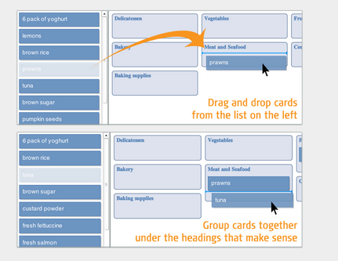
Next Steps
Card sorting software called Optimal Sort
Card sorting is a method of finding patterns in how users would expect to find content or functionality.
Generates an overall structure for your information, as well as suggestions for navigation, menus, and possible taxonomies.
Here is an example of what users saw when they opened the activity.

Slide 10
Card sort
There are 2 options for the card sort:
Open – Participants are given cards showing site content with no pre-established groupings.
They are asked to sort cards into groups that they feel are appropriate and then describe each group.
Open card sorting is useful as input to information structures in new or existing sites and products.
Closed – Participants are given cards showing site content with an established initial set of primary groups.
They are asked to place cards into these pre-established primary groups.
Closed card sorting is useful when adding new content to an existing structure, or for gaining additional feedback after an open card sort.

Slide 11
Next Steps
We used an open card sort
Participants are given cards showing site content with no pre-established groupings
They are asked to sort cards into groups that they feel are appropriate and then describe each group.
Open card sorting is useful for inputting information into structures in new or existing sites and products
15 Participants, professionals and students
Card sorting activity was separated into 2 sections:
Standards
Educational Resources
Time to complete, 15-20 minutes each.

Slide 12
Card Sorting Results
Users sorted the Standards Section into:
HFES Standards
Standards at HFES
Purchasing standards
General Info About Standards
Definition of Standards
Importance of Standards
Purpose of Standards
Who Standards Benefit
The content of a Standard
Other Standard Organizations
ANSI
About ANSI and History
ISO
About ISO and history
Getting involved in Standards
Standards Development
Technical Committees

Slide 13
Card Sorting Results
Edu. Section is not solely devoted to Standards, but we treated the card sorting activity the same as the Standards Section
Users sorted the Educational Resources Sections into:
Resources Materials About Standards
Learn About Standards
History of Standards
Presentations on Standards
Resources for learning
Human Factors Related Standards
Government Standards on H/F Designs
List of Human Factors Standards
Standards related to Accessibility
Standard Development
Development of Standards
ANSI Development Process
ISO Development Process

Slide 14
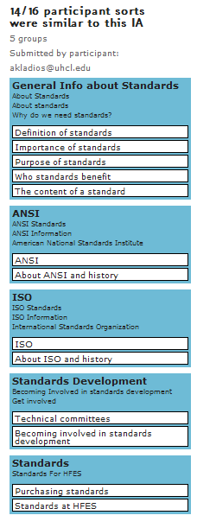
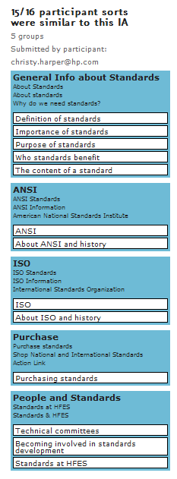
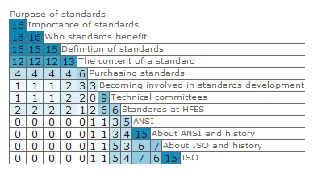
Card sort Results - Standards
Structure of the prototype was derived from here.
Similarity Matrix – a matrix of scores which express the similarity between two data points

Slide 15
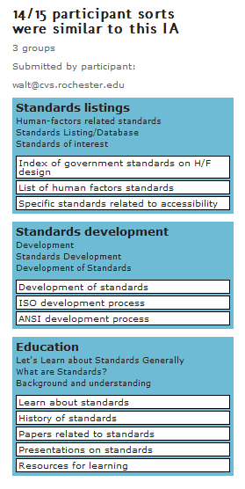
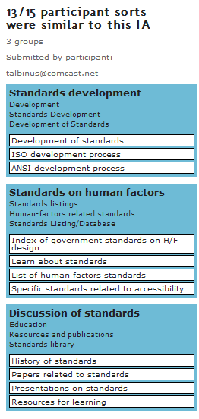
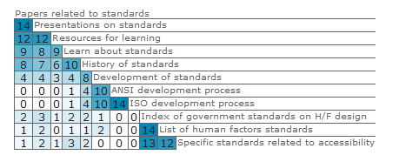
Card Sort Results - Educational

Slide 16
Usability Testing
Users were presented tasks and asked to use the prototype
8 Tasks:
Find HFES standards publication
Where would you go to buy a standards
Locate other standards
Who else offers standards
Where would you go to learn about standards
Find standards related to accessibility
How are standards made
Contact person for HFES standards
Users were rated on whether tasks were completed

Slide 17
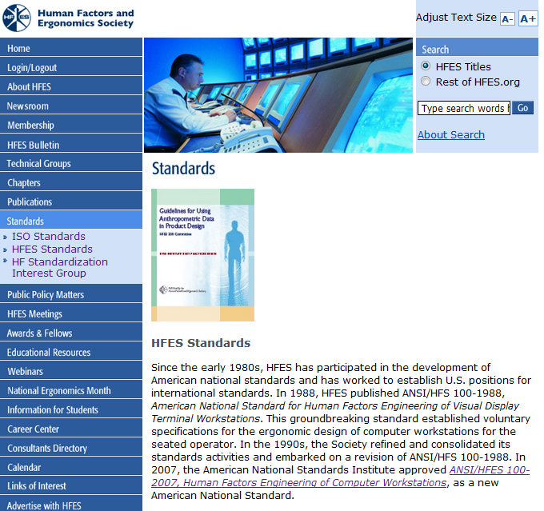
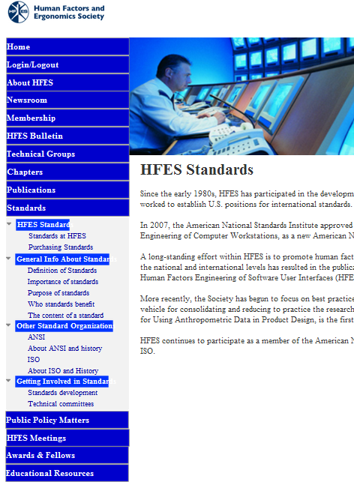
BEFORE
PROTOTYPE
Increased pathways for easier navigation
Reduced amount of content, separated into smaller sections

Slide 18
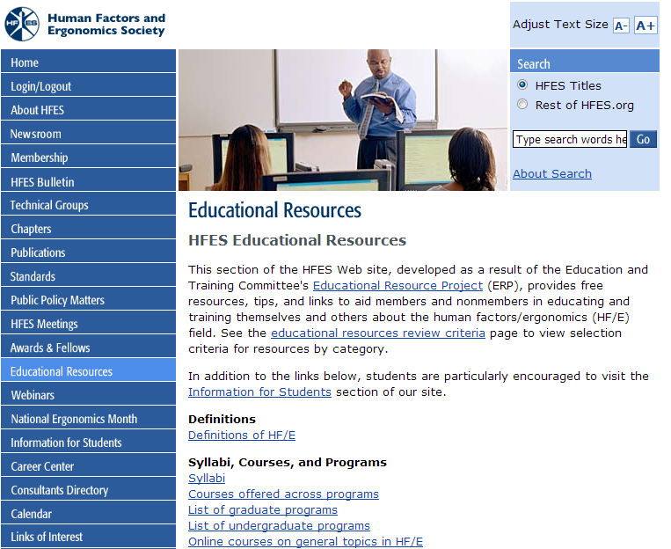
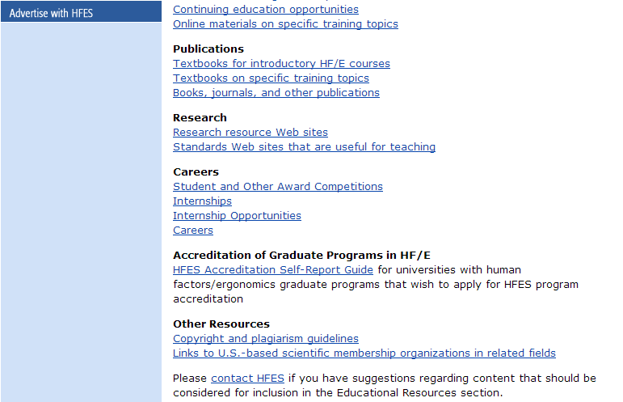
Educational Resources
Red line represents “below the fold”
Link for Standards is here!
Notes:
The standards piece lies below the fold, so it is easy to miss and it is listed in the Research Section
Also, it is buried in a large amount of texts and links.

Slide 19
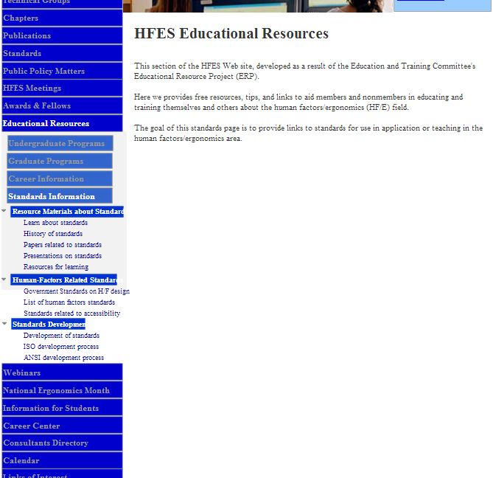
Prototype
Reduced amount of content to match Standards section
Added navigation tabs for Standards within Educational Resources Section
Notes:
The Content for the sections were not the primary goal of this exercise

Slide 20
Testing Results
0 - was not able to complete task 1 - was able to complete task with difficulty 2 - was able to complete task without difficulty | Participant 1 | Participant 2 | Participant 3 | Participant 4 | Participant 5
Find HFES’ Standards Publications | 2 | 2 | 2 | 2 | 1
Buying a standard | 2 | 2 | 2 | 2 | 2
Locate other standards | 2 | 2 | 1 | 2 | 2
Who else offers Standards? | 2 | 2 | 2 | 2 | 2
Where would you go to learn about Standards? | 0 | 0 | 0 | 0 | 0
Find Standards related to accessibility | 2 | 2 | 2 | 1 | 2
How are standards made? | 2 | 2 | 2 | 2 | 1
How would you contact someone @ HFES to ask more about standards? | 0 | 0 | 0 | 0 | 1

Slide 21
Summary and Conclusions
Summary:
Increasing navigation pathways increased navigation success, 75%.
Of the 75% only a few completed tasks with difficulty
Navigating to sections within Educational Resources remains problematic
Majority of users were confused as to why standards are separated into 2 sections.
“I would never think to look in Educational Resources, not if I’m looking for standards”
“Why are they separated? Everything should be together, much easier that way”
Conclusion
Overall, the new design increased successful navigation.
“For the most part, it was very easy to use”

Slide 22
Recommendations
Reduce overall content on landing pages.
Users did not spend anytime reading the current material
Aesthetics are also important to users
Provide a more detailed left navigation
Users were able to find what they were looking for at a glance
Users did not need to remember where to go
Provide a link to the Educational Resources section within the standards sections.
All the users went to the Standards section first
Users expressed confusion as to why they needed to navigate to Educational Resources to access standards.
The title gives no indication that standards would be there.
Infrequent or new users will be able to access the standards in the education section if they need more information.

Slide 23
Thank You

